Slide 1
Undersmoothed HAL-based plugin estimator for direct/indirect effects
Develop and test undersmoothed HAL-based plugin estimator for direct/indirect effects, or other more complex parameters.
Seraphina

Slide 2
Undersmoothing
Getting the initial lambda
from a HAL fit with smoothness_orders = 1
Getting the undersmoothed lambda:
Generate a panel of lambdas
CV lambda * seq(from=0, to=-3, length=20)
Pick the first lambda that satisfies the criteria:
Max score <= 1/(sqrt(n) * log(n))
Where max score = max(|E[(Y – Y_hat)(H/sigma_n)]|)

Slide 3
Controlled direct effects
Data structure:
W: baseline, continuous
A: treatment dosage, continuous, bounded
Z: intermediate curve, binary
Y: outcome, binary
Causal target parameter:
Dose response curve, over grid of a

Slide 4
Controlled direct effects - simulations
Generate data with given sample size n with the given DGD
Fitting the Y ~ X directly with undersmoothed HAL using the sample once
max_degree = 3
smoothness_orders = 1
base_num_knots_0 = 20
base_num_knots_1 = 20
Estimating the targeted parameter by calculating the simple substitution estimator
Predicting given a and z
using the fitted undersmoothed HAL for all combinations of a and z

Slide 6
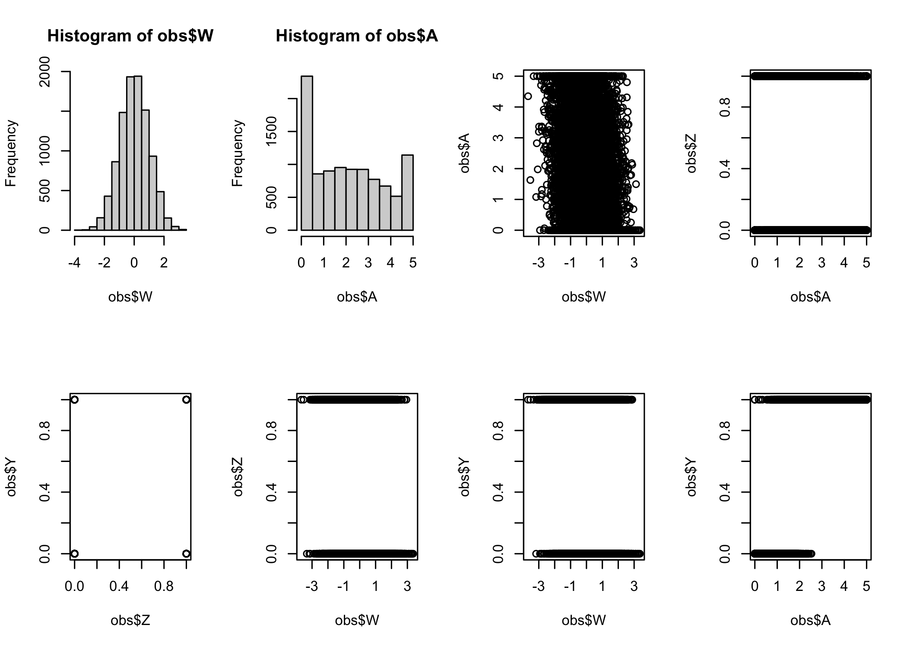
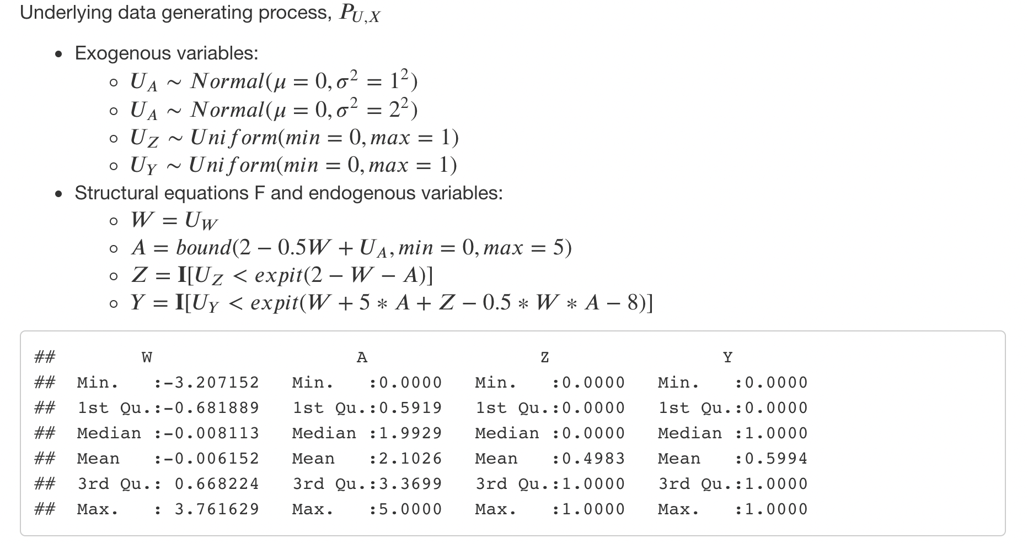
Simulation #1

Slide 7
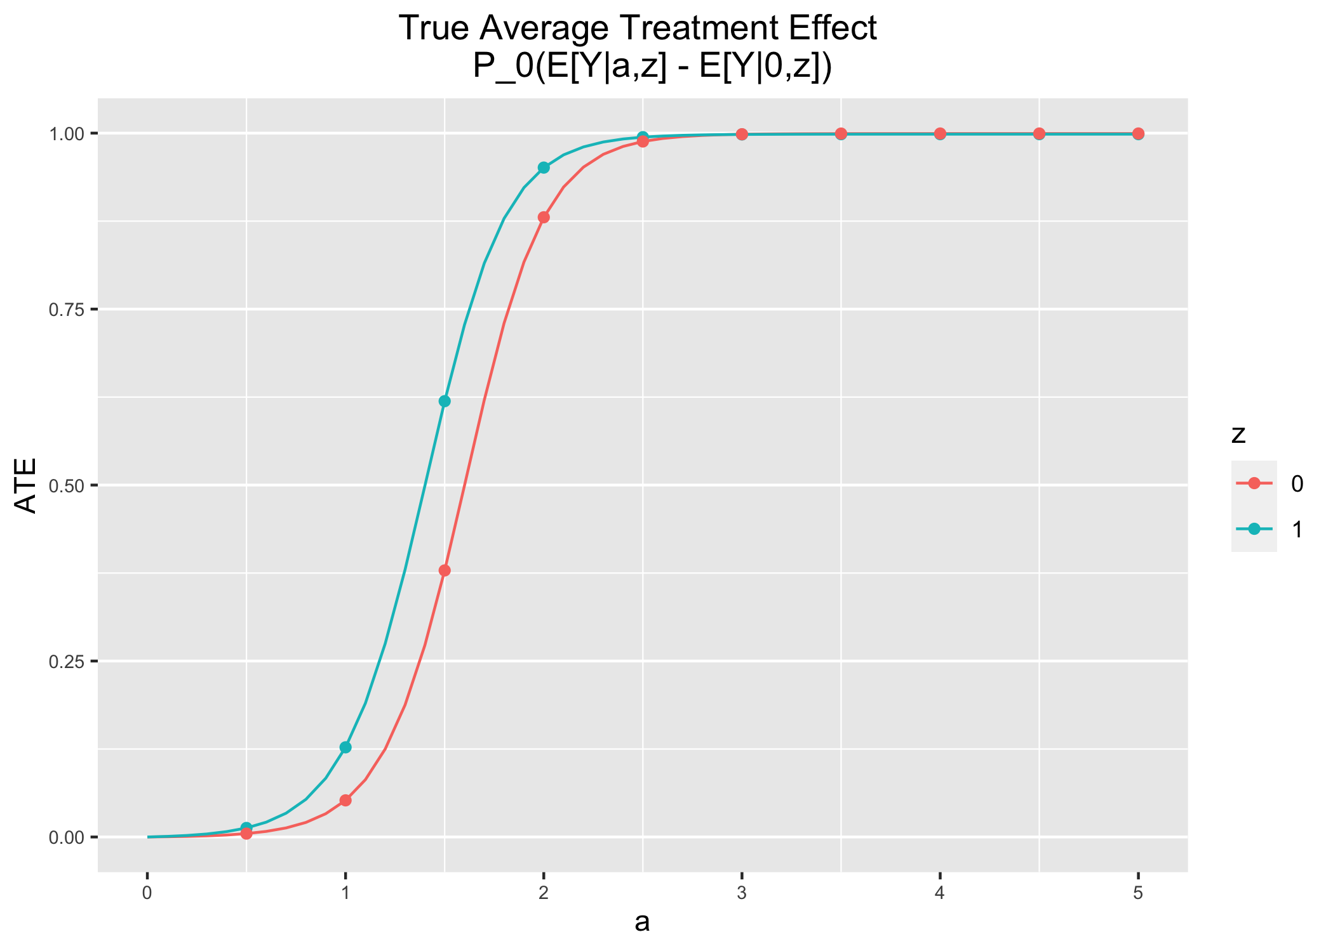
Simulation #1

Slide 8
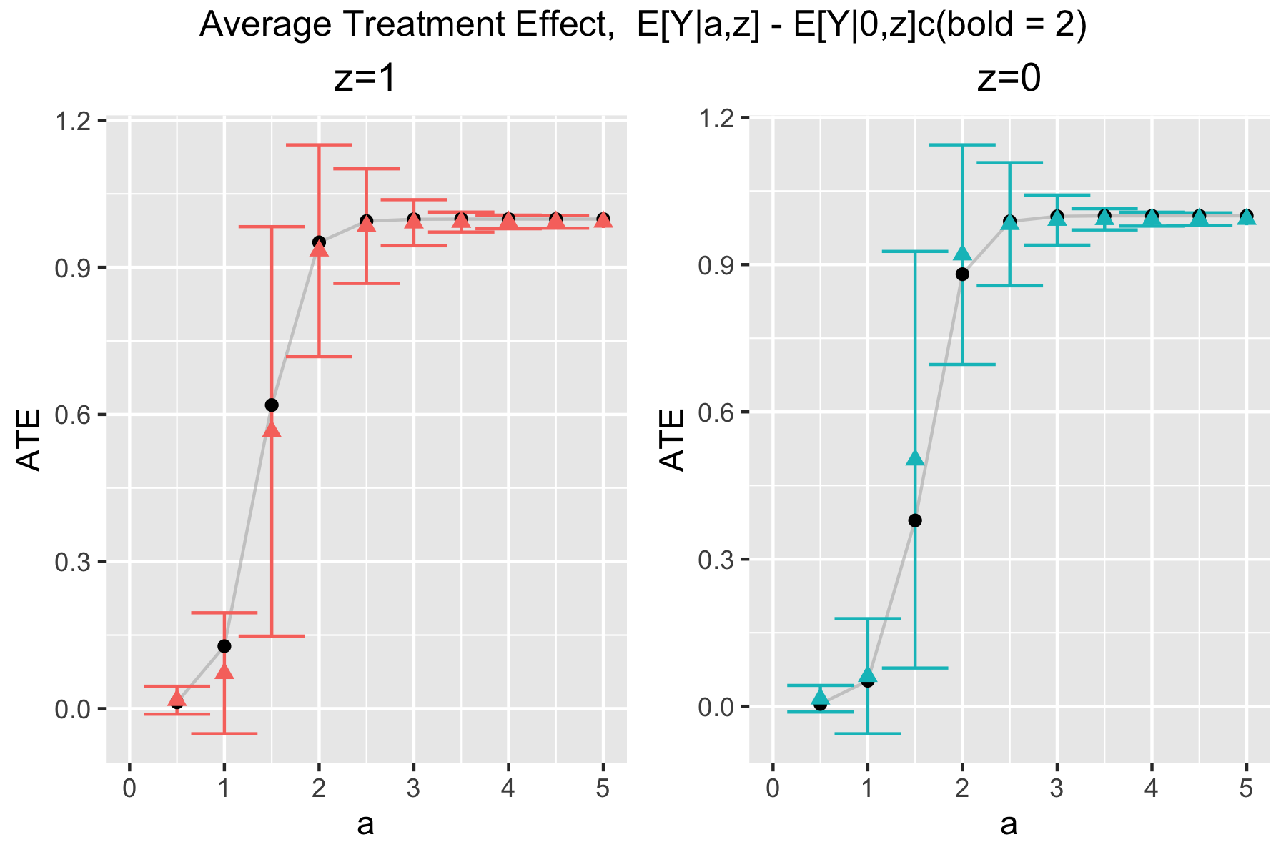
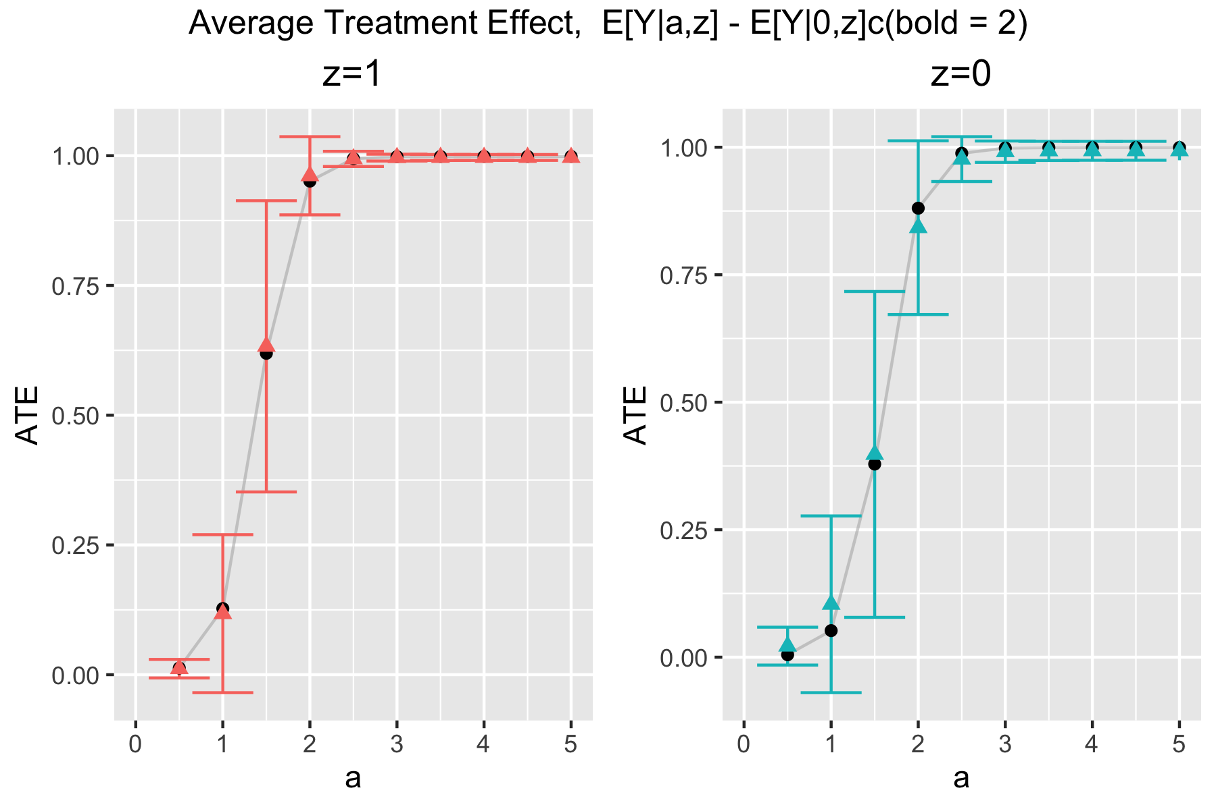
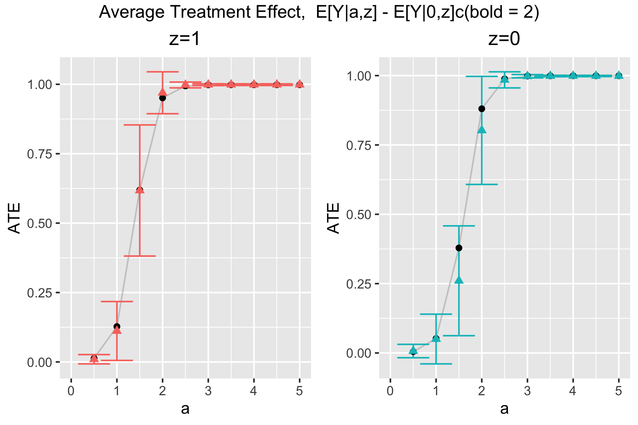
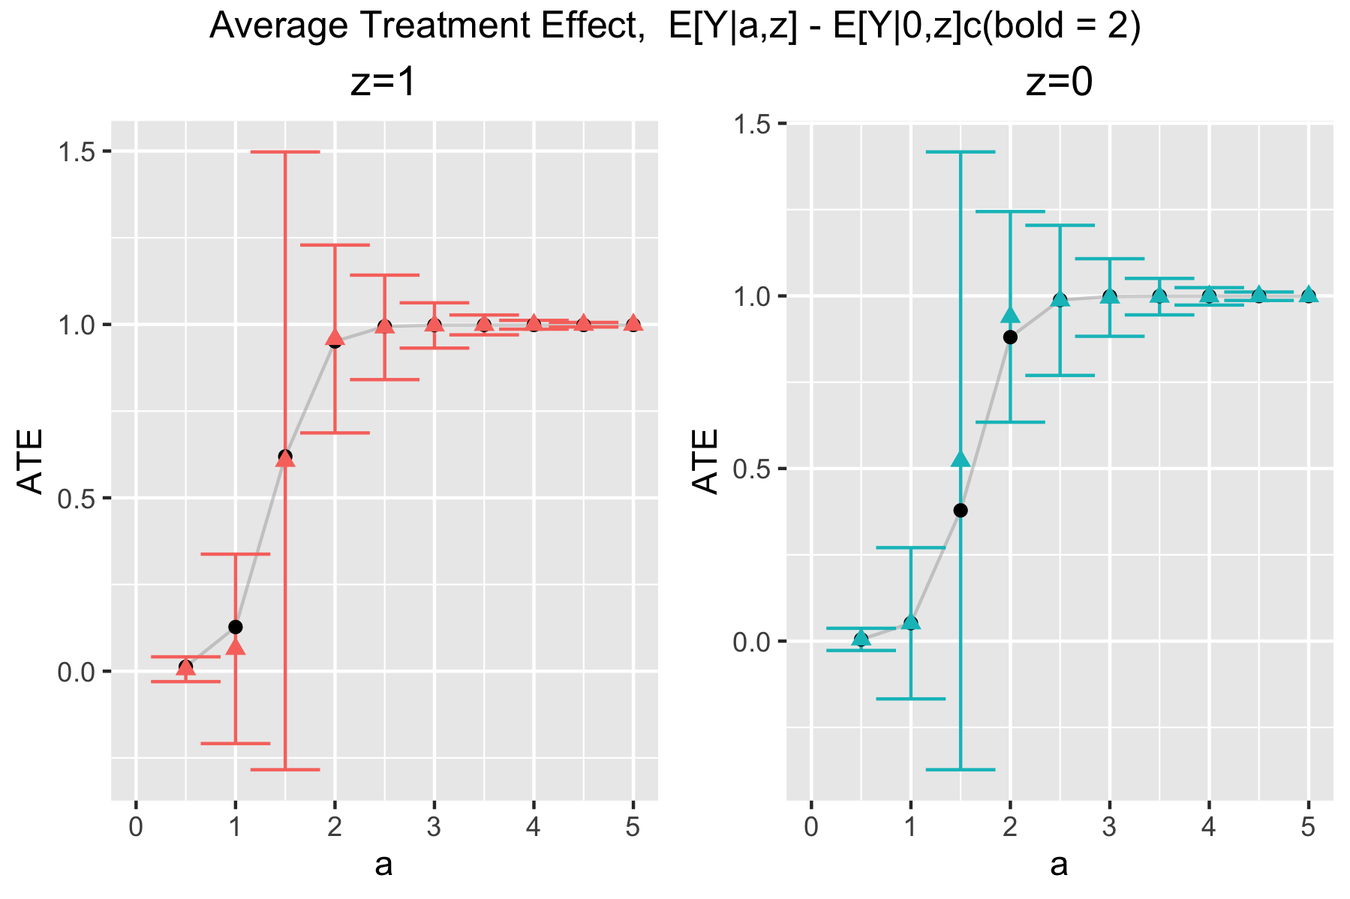
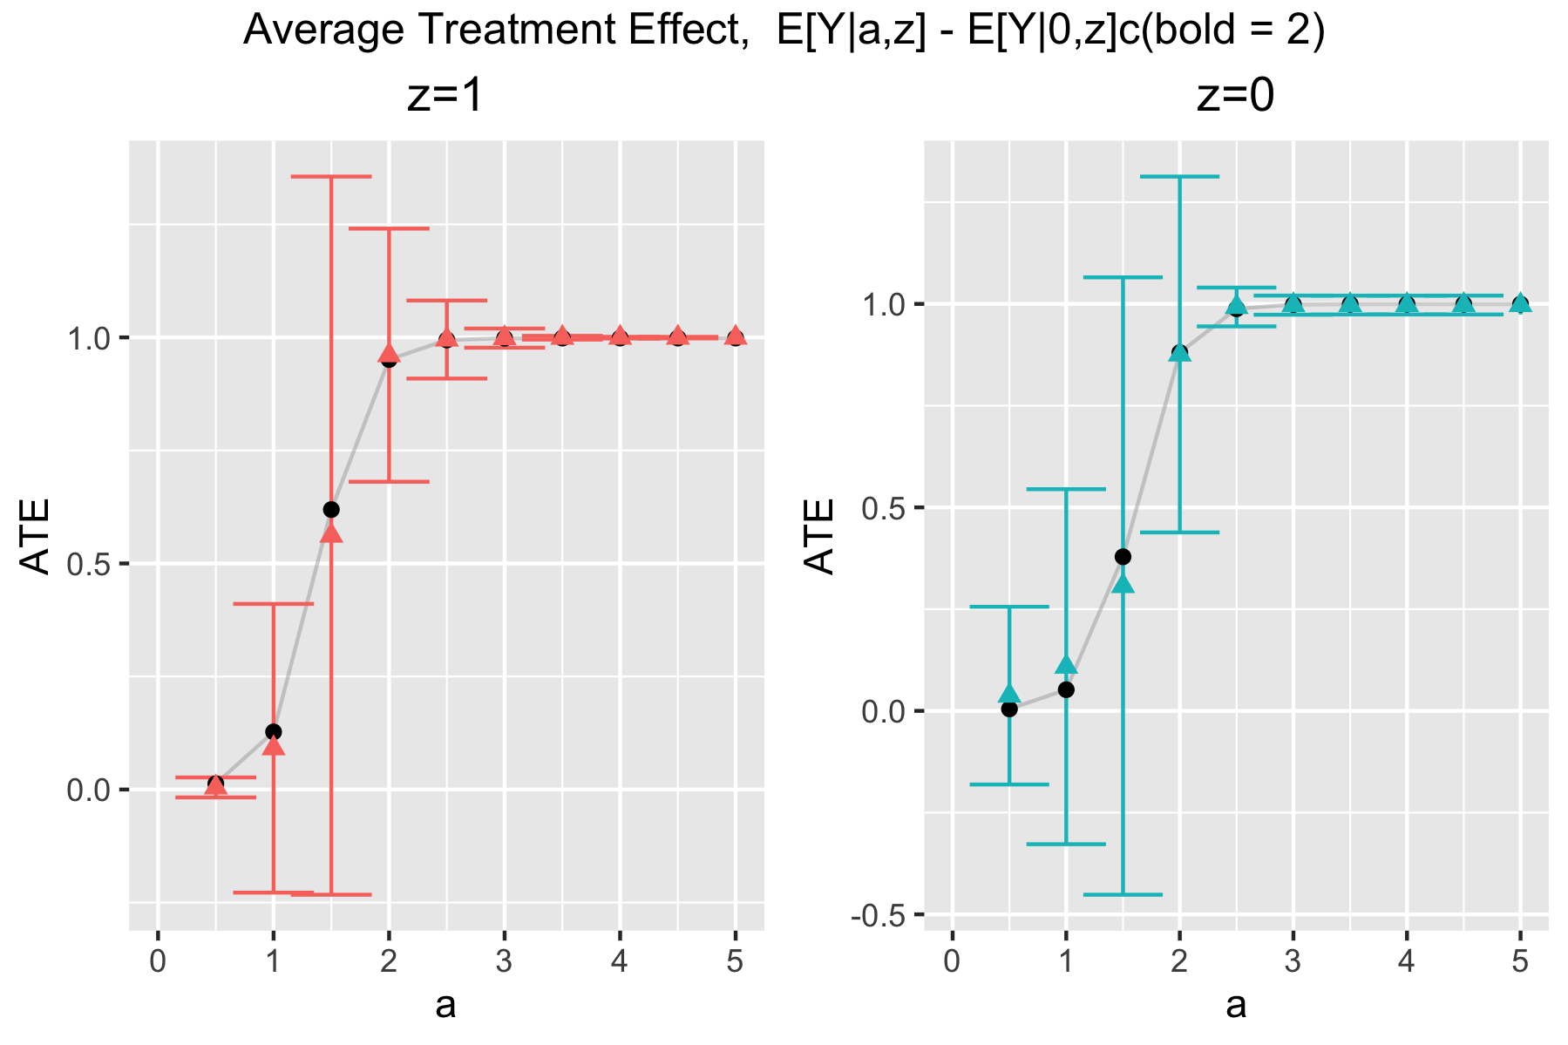
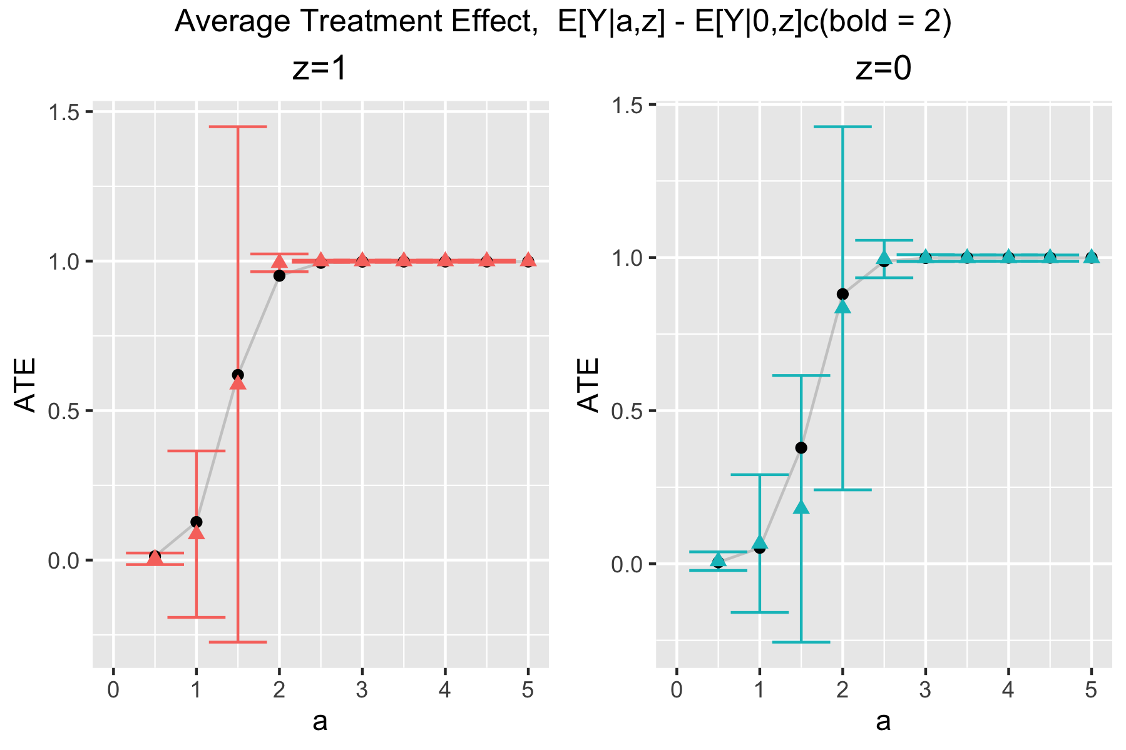
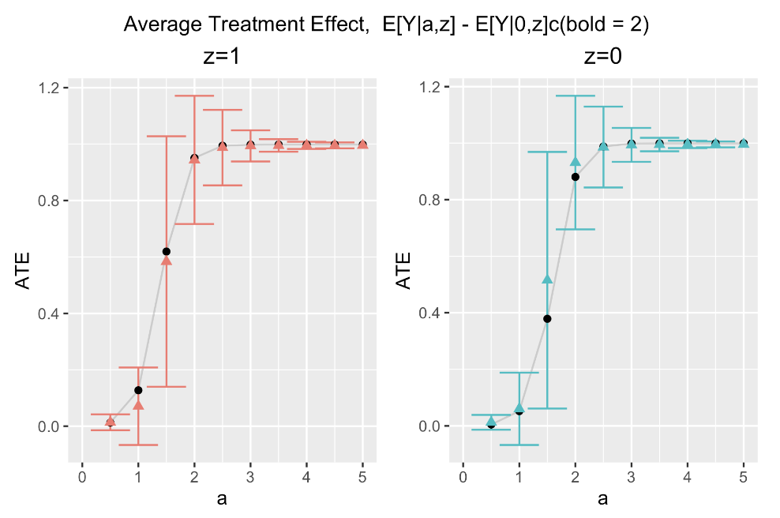
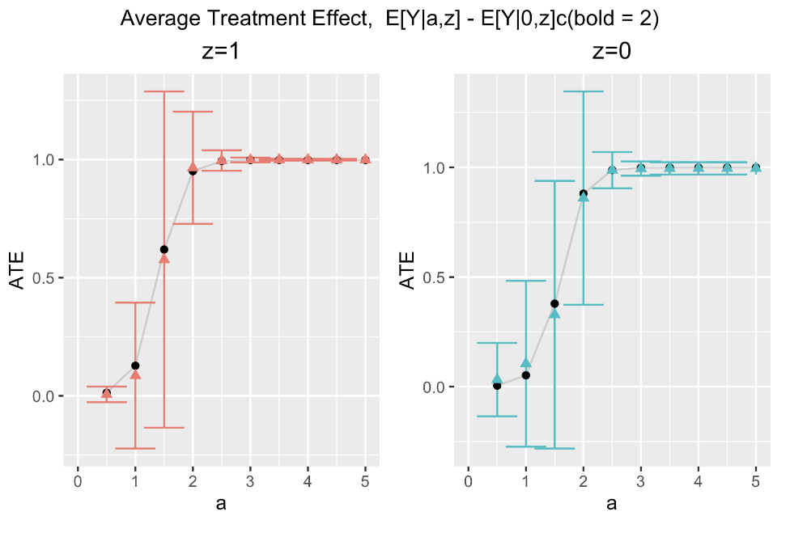
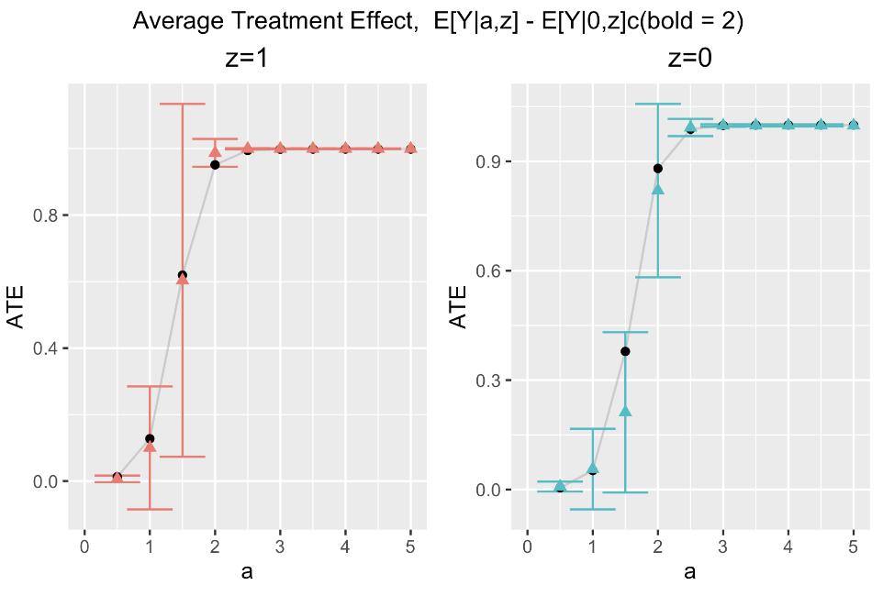
1 Sample
n = 200
n = 500
n = 1000
CV-HAL
Globally
undersmoothed
HAL
undersmoothed
HAL with min local lambda

Slide 9
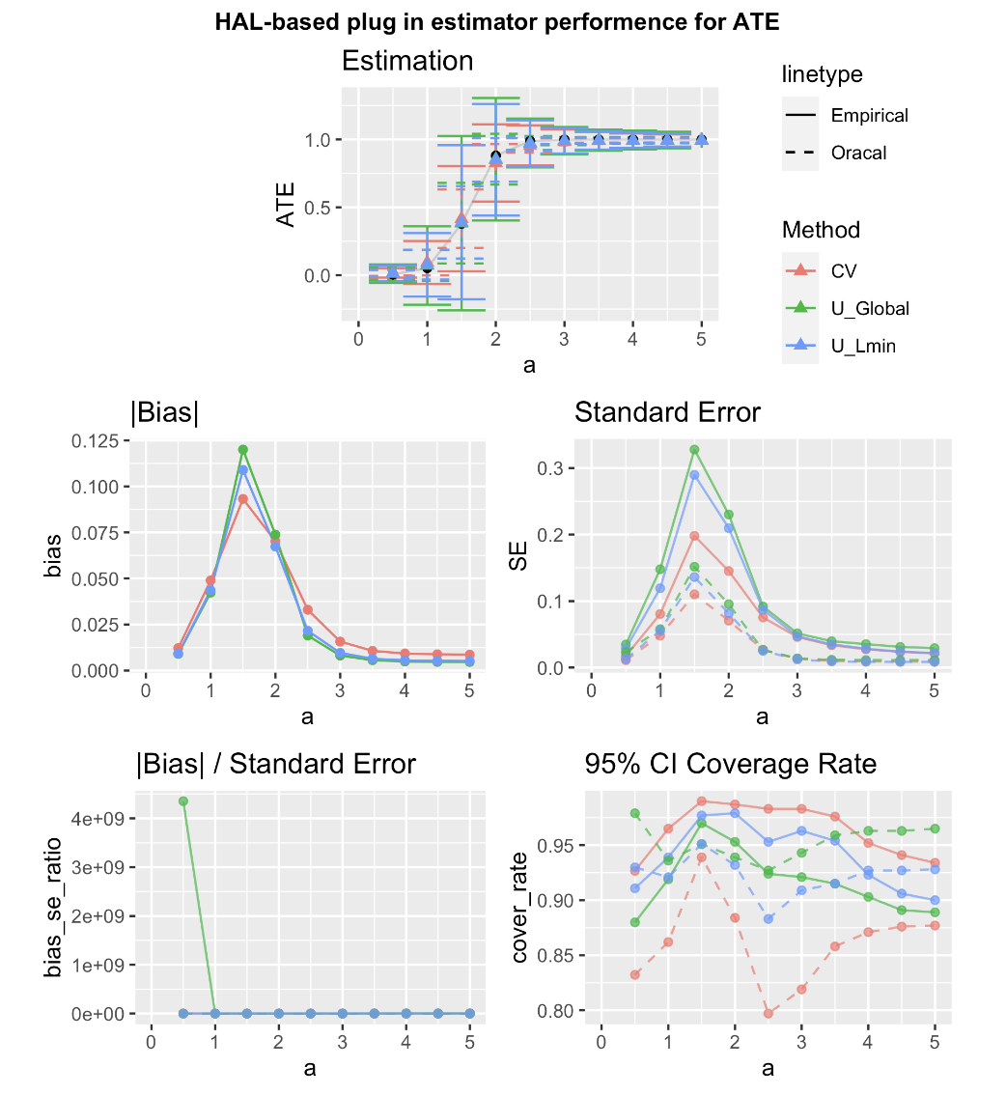
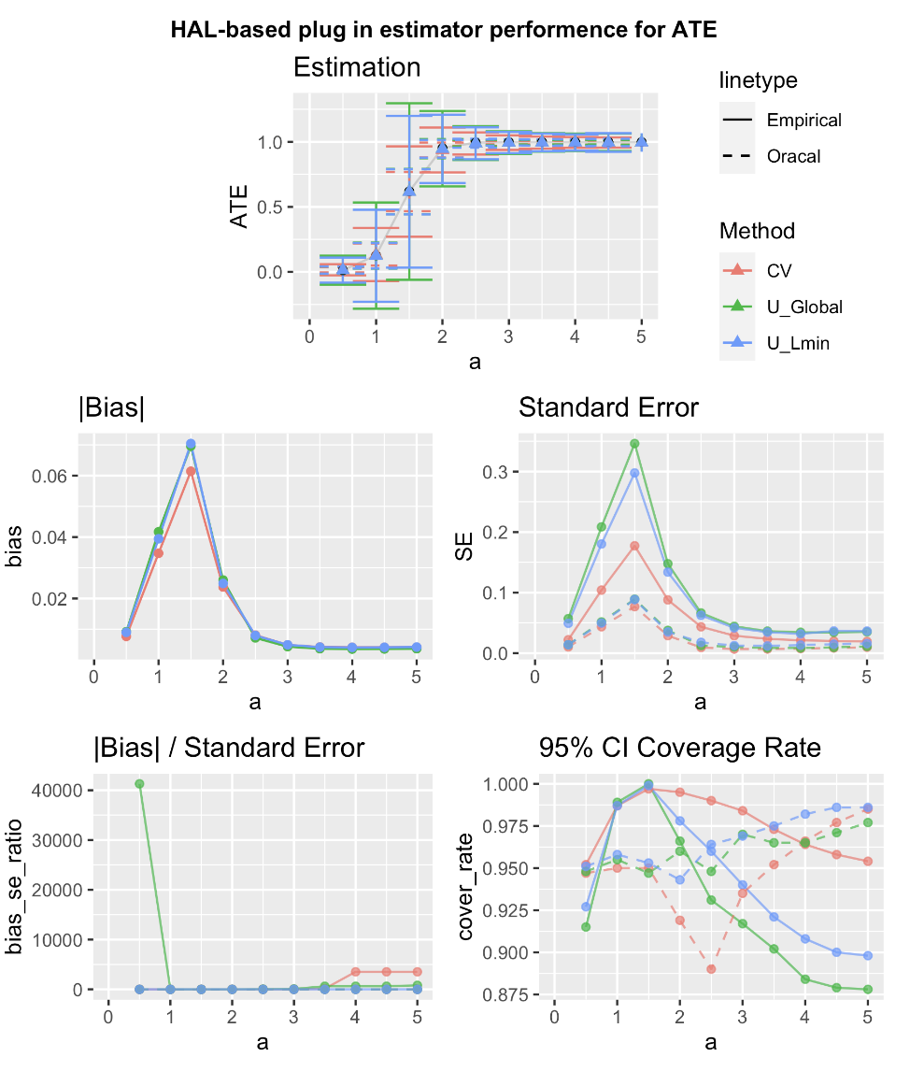
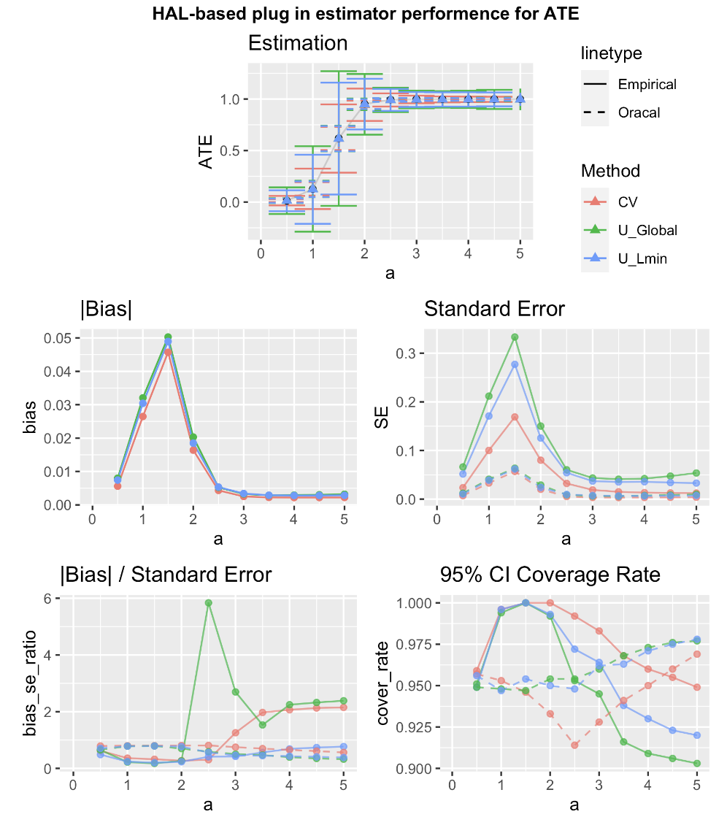
Z = 1
n = 200
n = 500
n = 1000
Notes:
Red lines are results from using L1 Penalty based on minimizing CV-risk (CV-HAL).
Blue lines are results using an empirical derived global undersmoothing based repeated simulations over a grid of L1 penalties and choosing the maximal one for which the bias becomes negligible.
Results are shown for a grid over A=a. Dashed line is based on the Oracle SD of the estimator, solid on the empirical delta method.

Slide 10
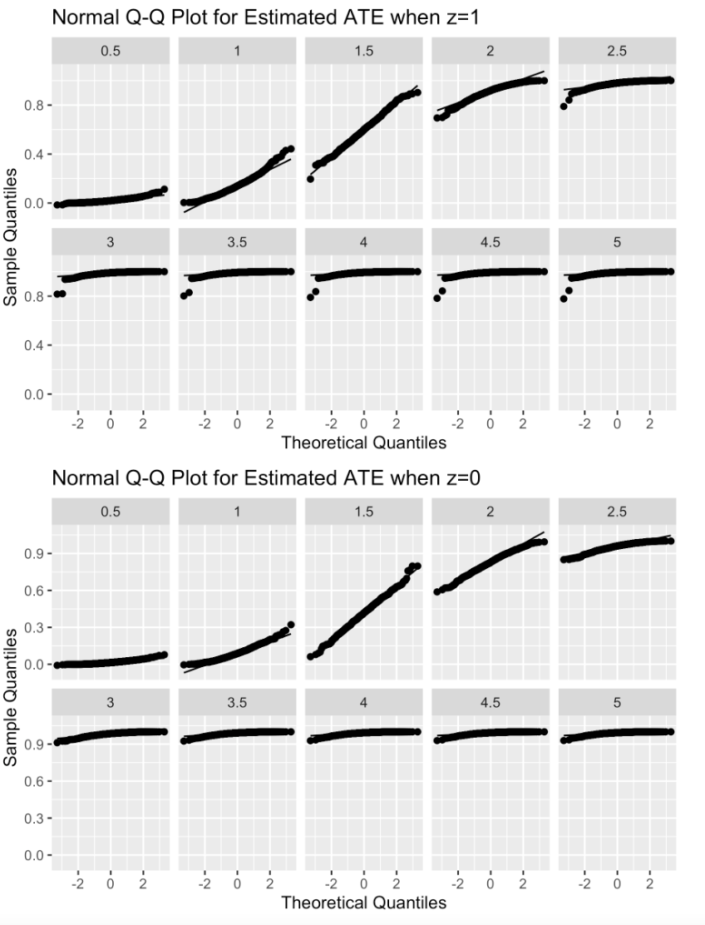
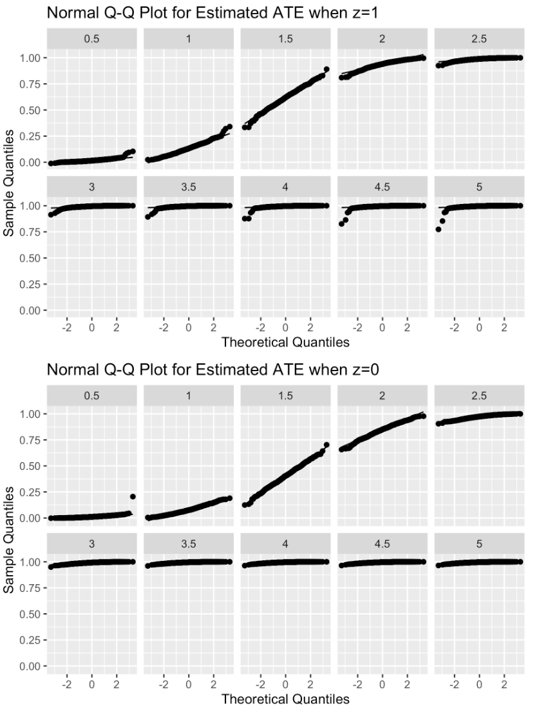
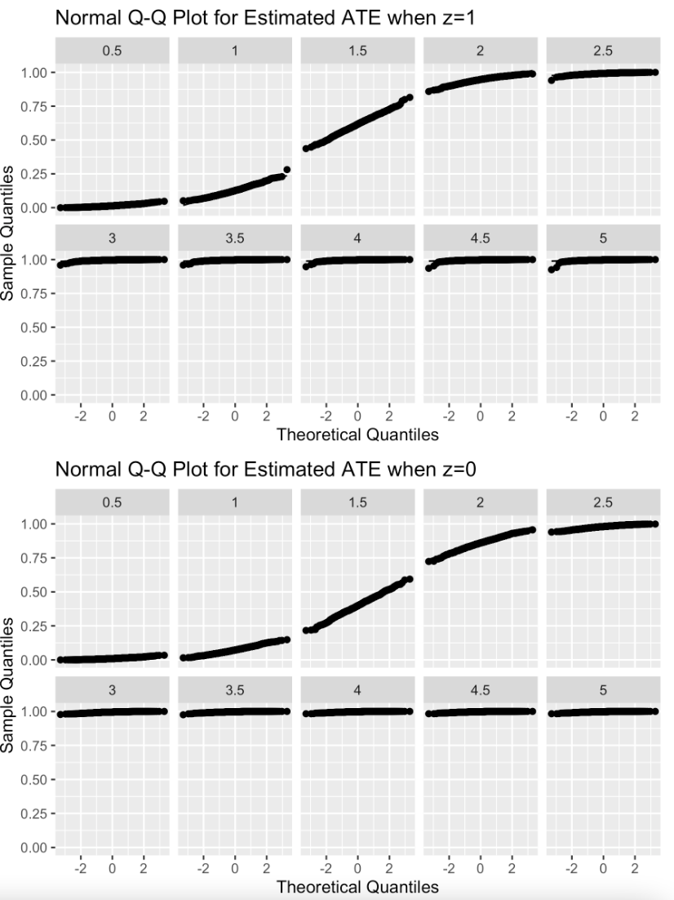
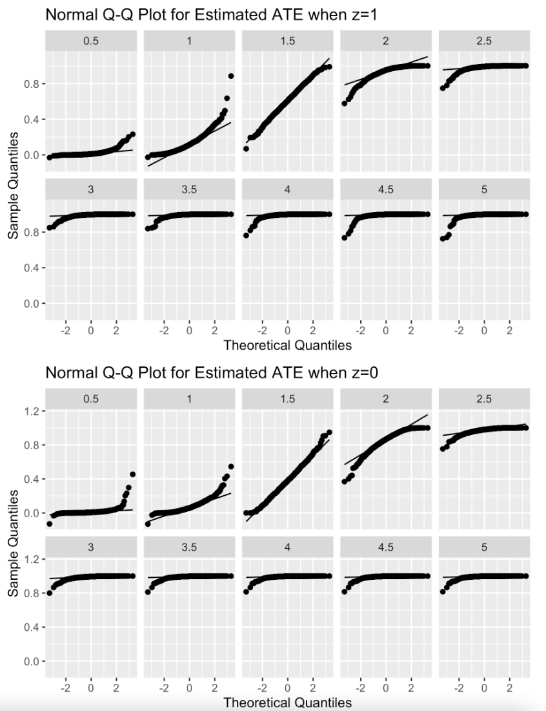
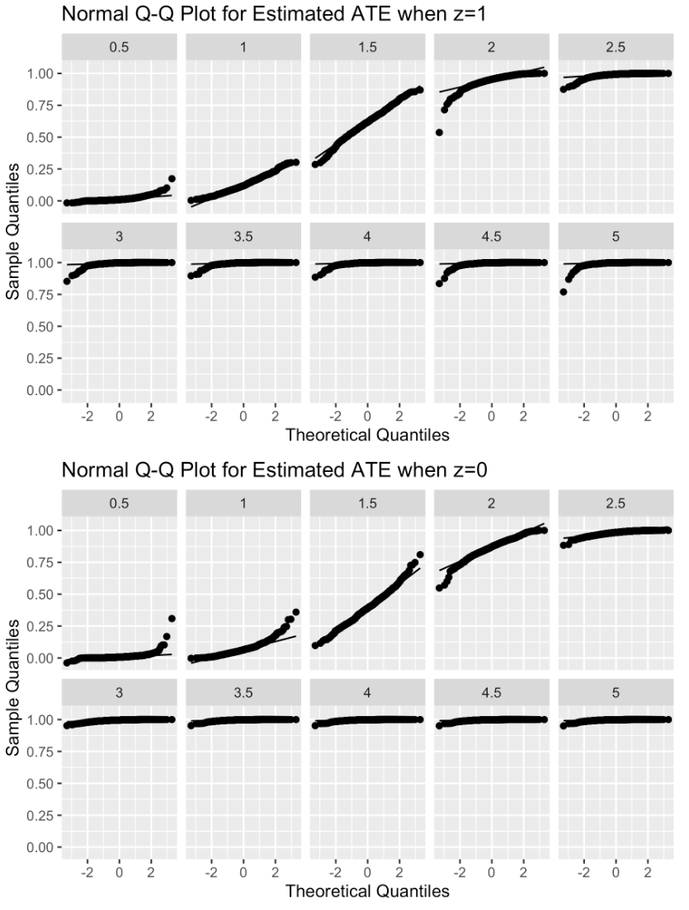
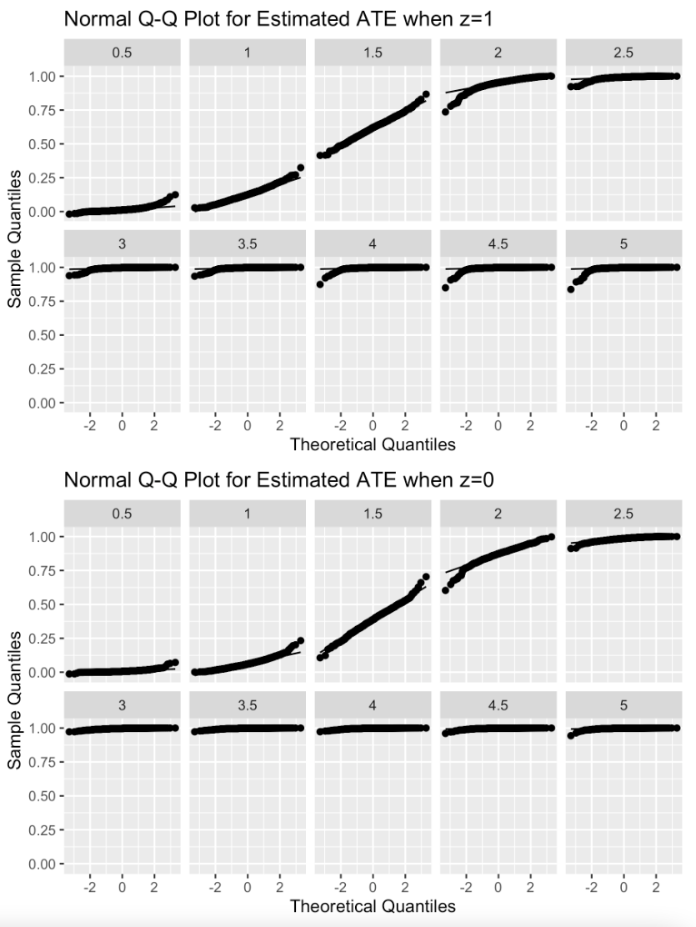
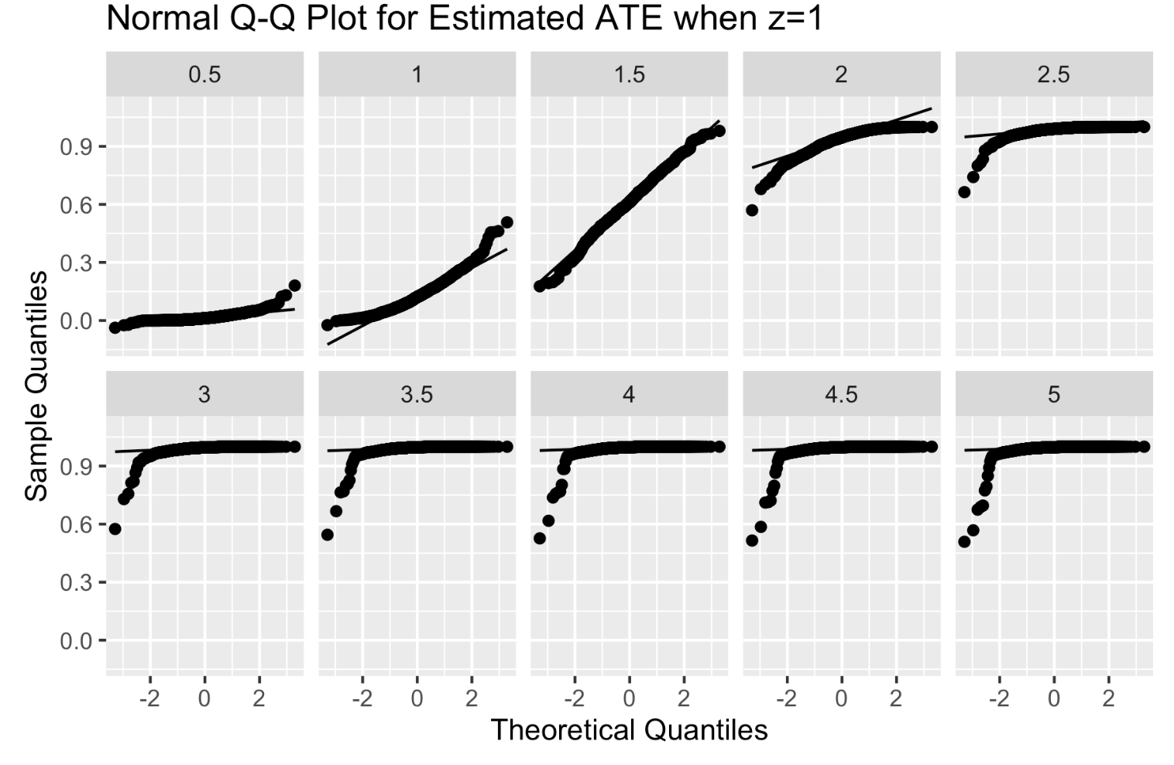
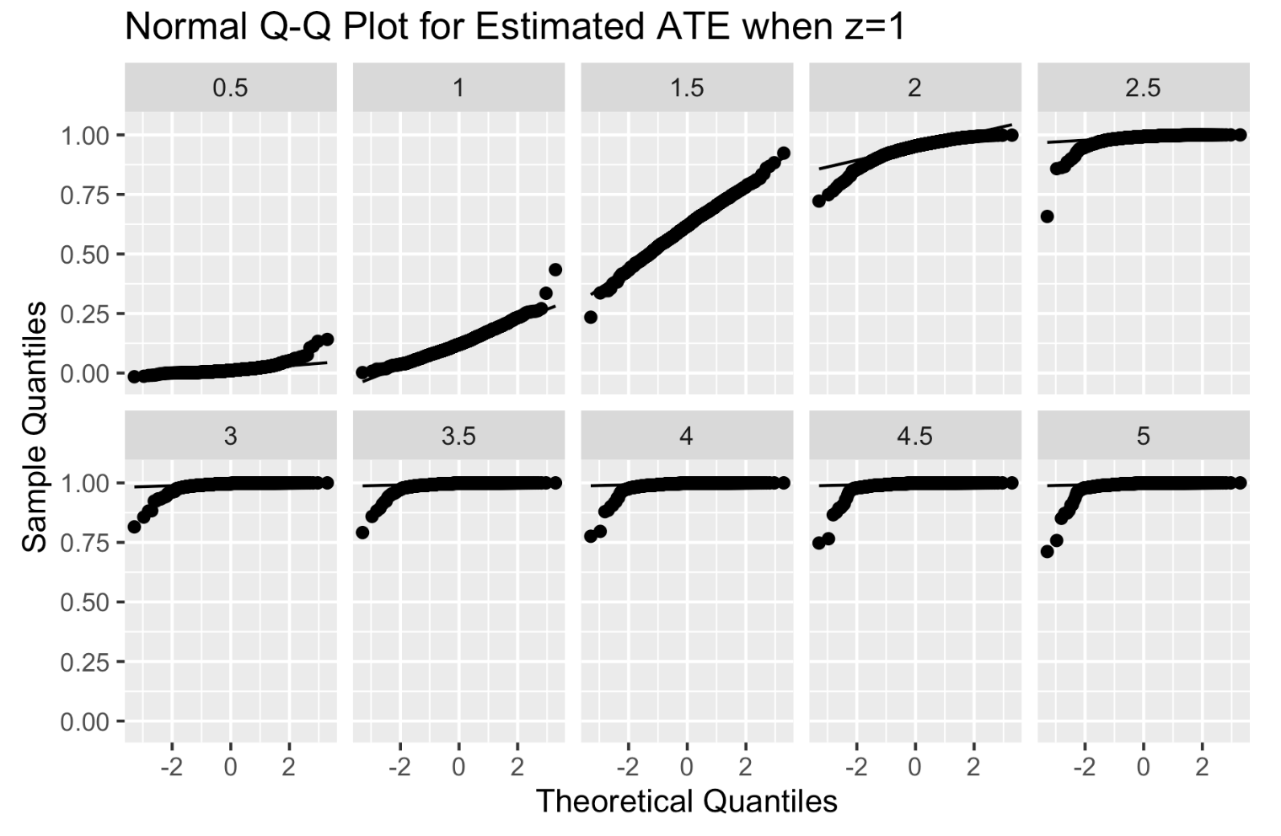
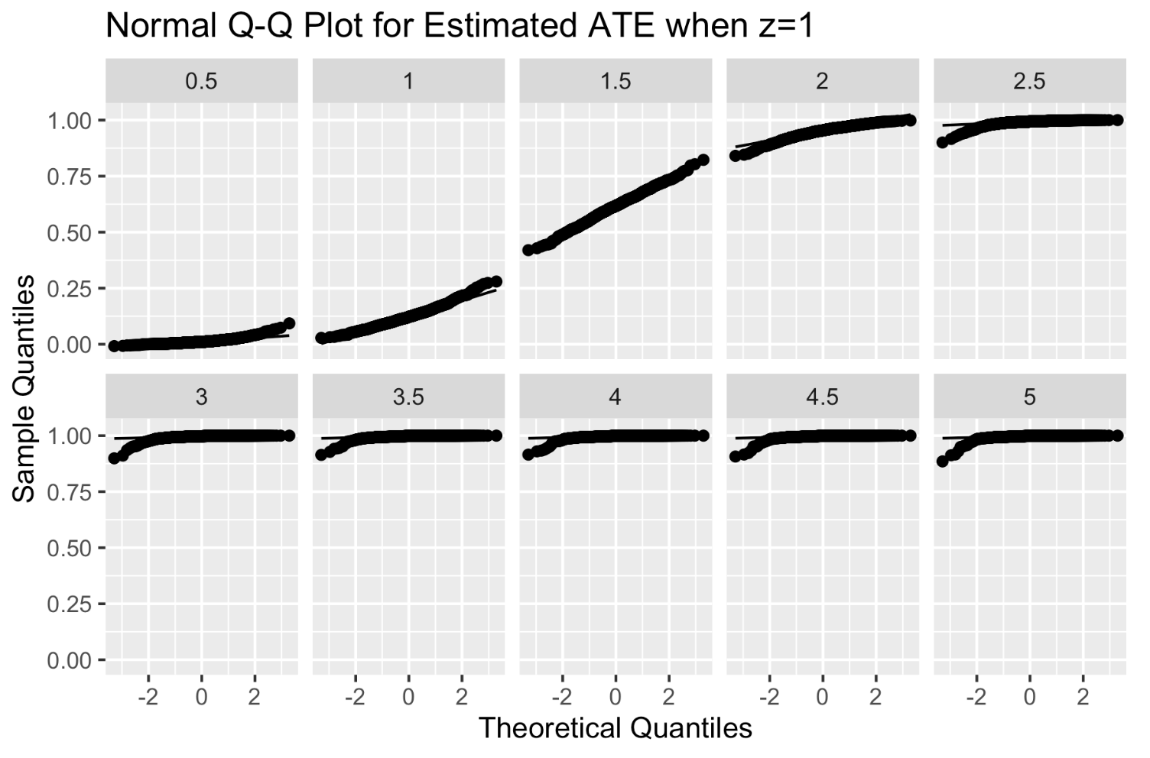
1000 Sample
n = 200
n = 500
n = 1000
CV-HAL
Globally
U-HAL
undersmoothed
HAL with min local lambda

Slide 11
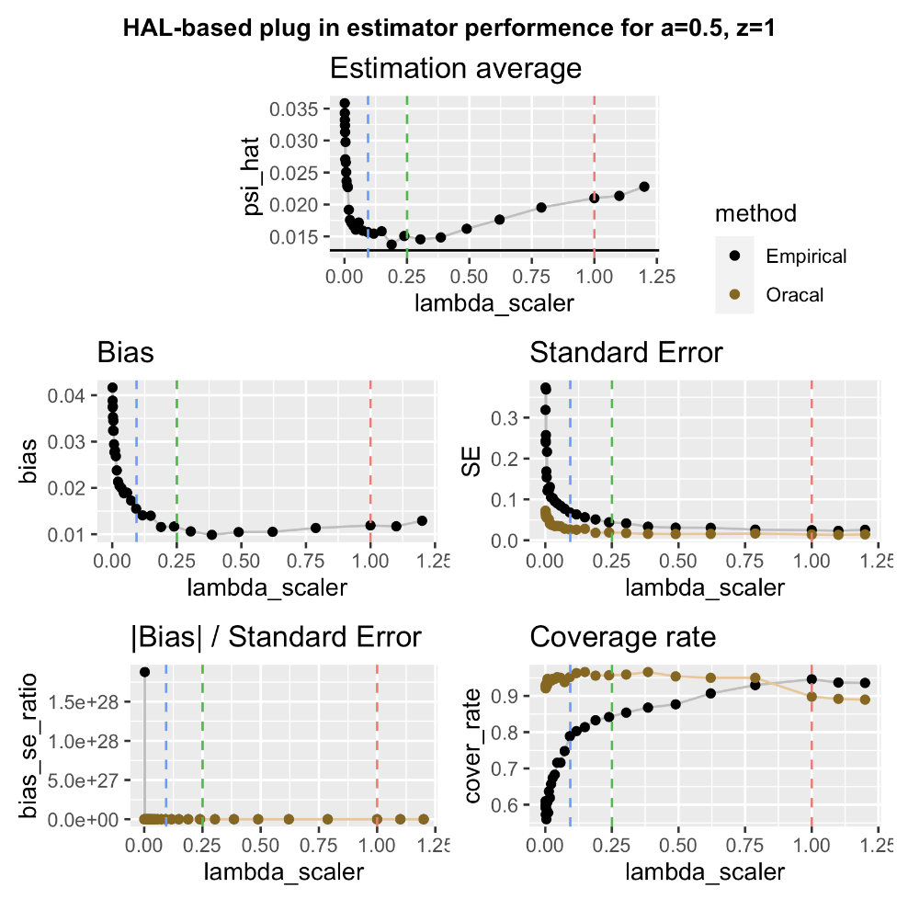
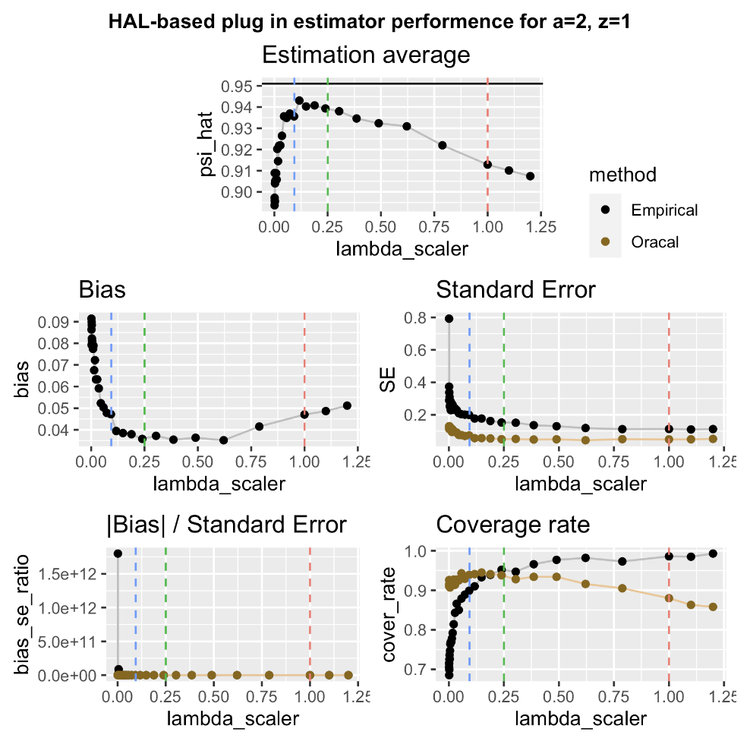
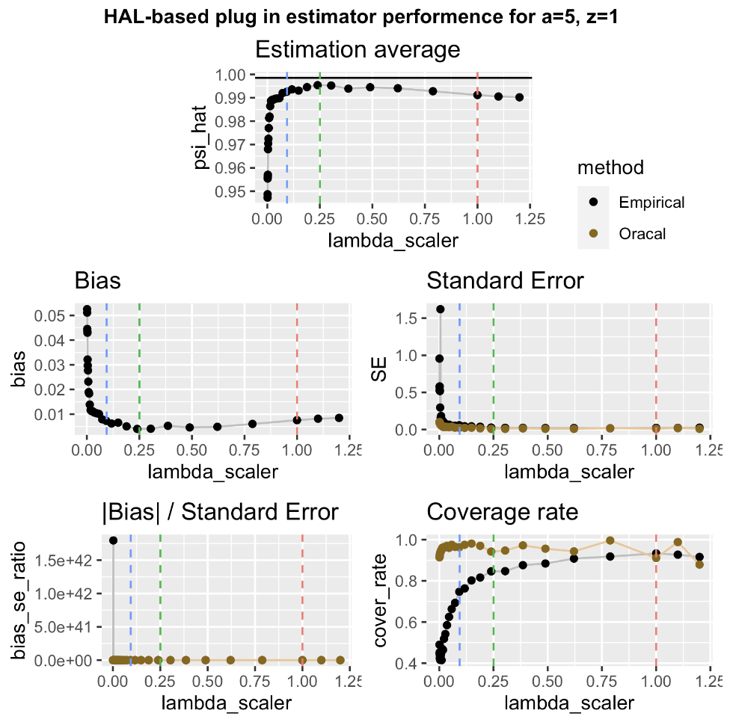
1000 Samples, n=200

Slide 12
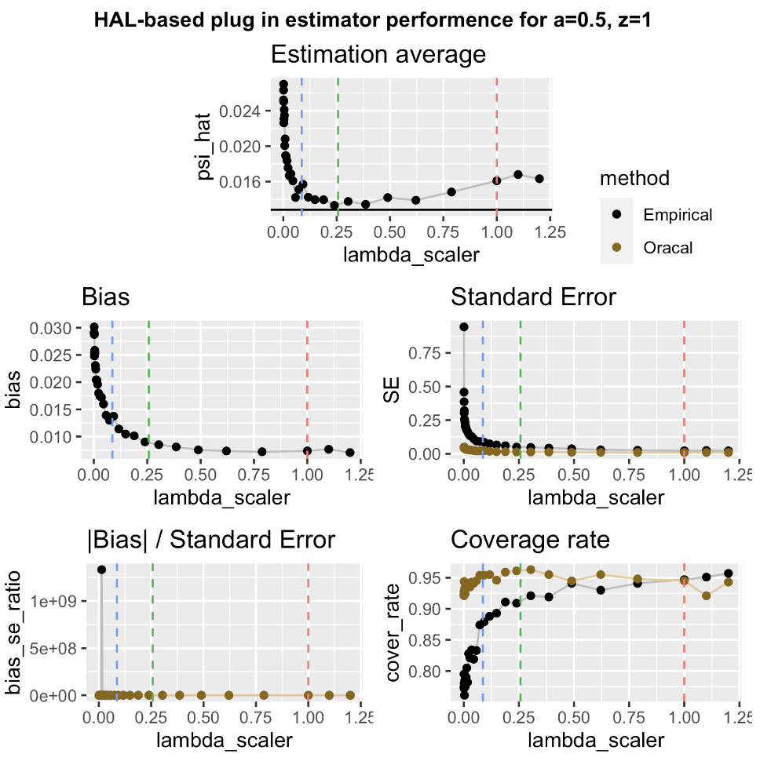
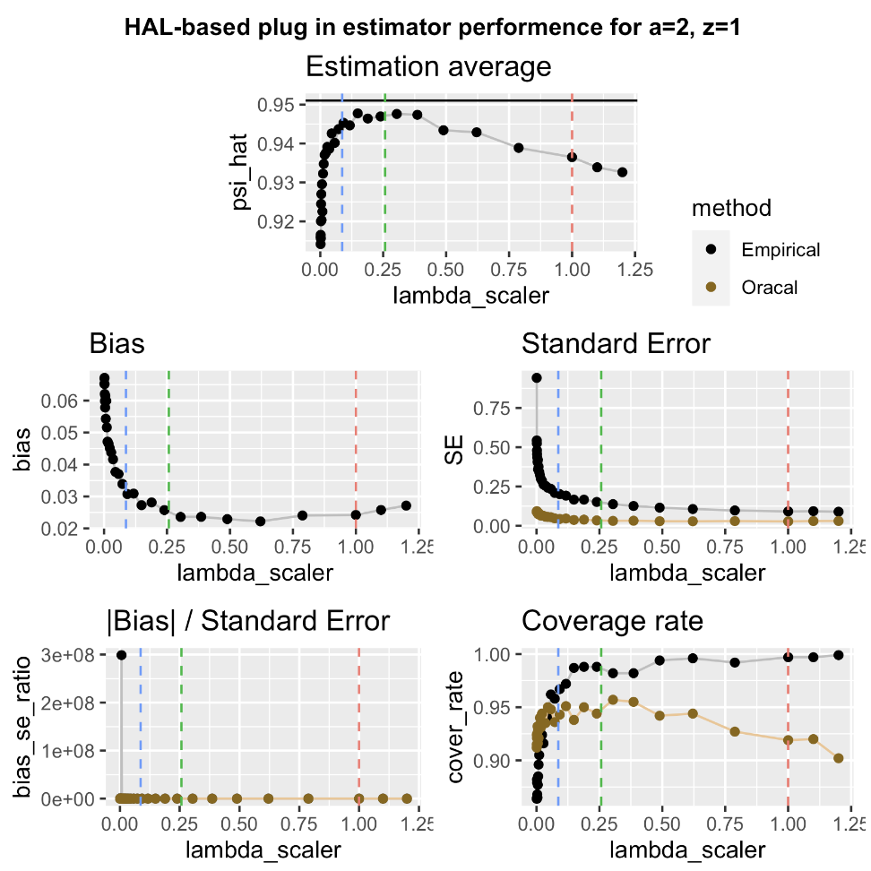
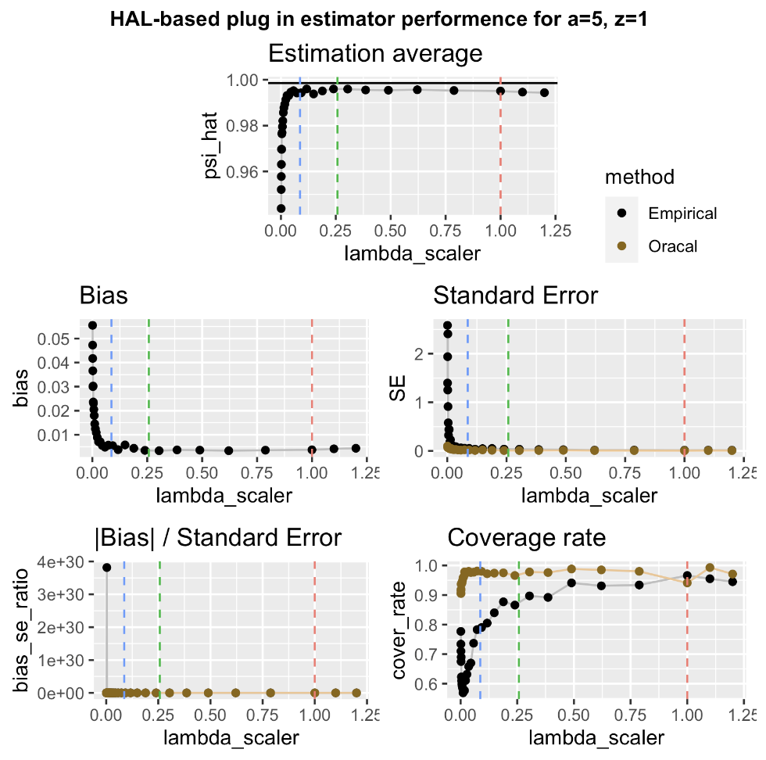
1000 Samples, n=500

Slide 13
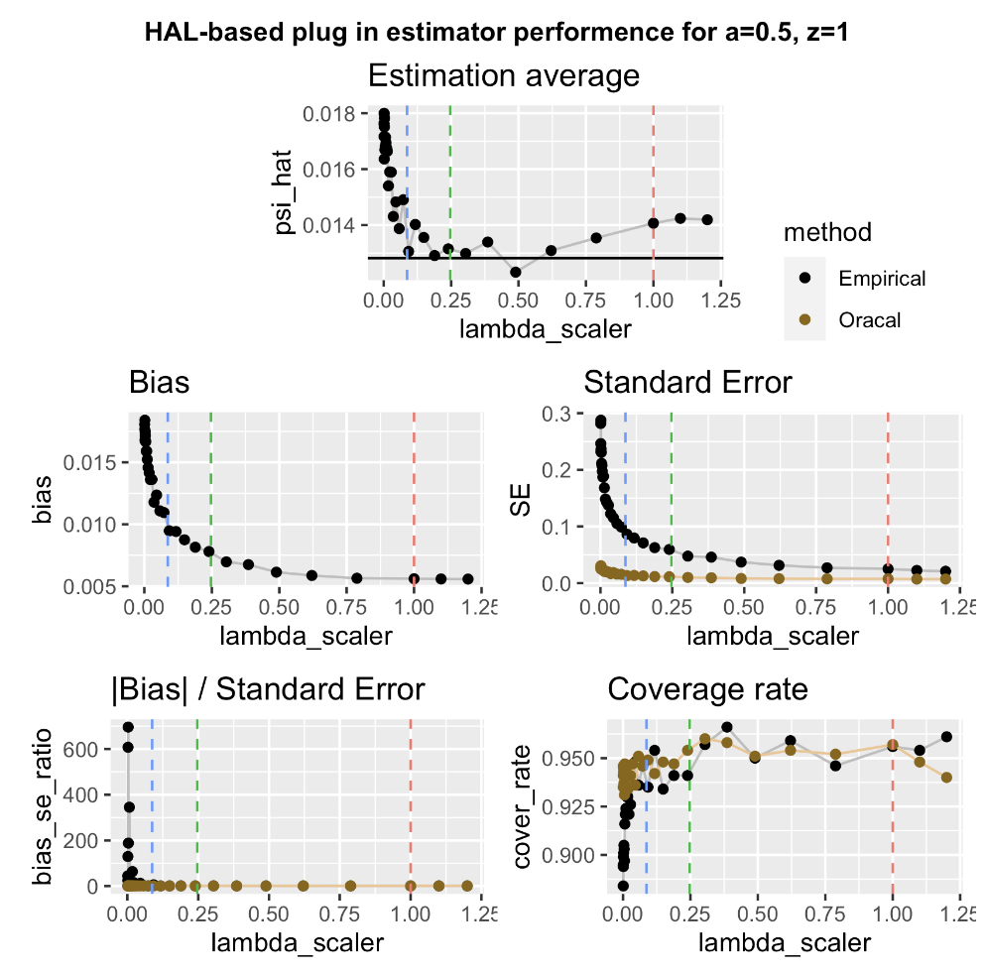
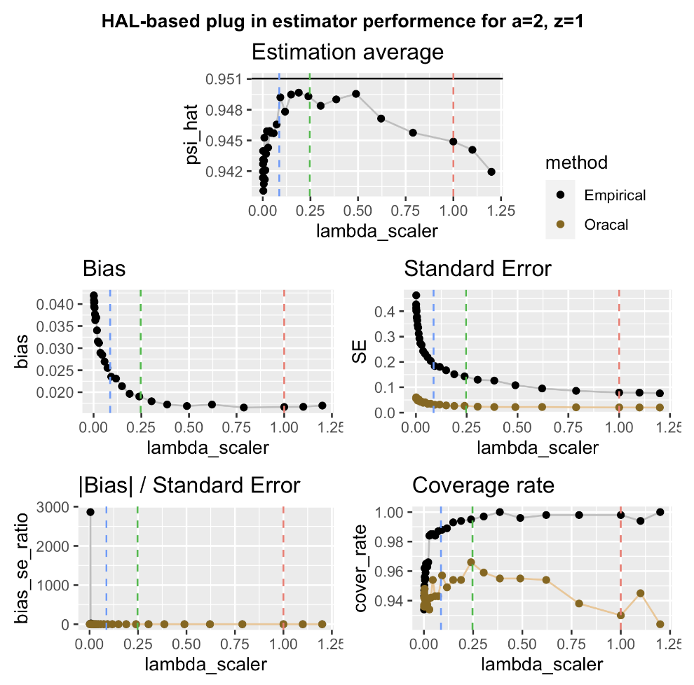
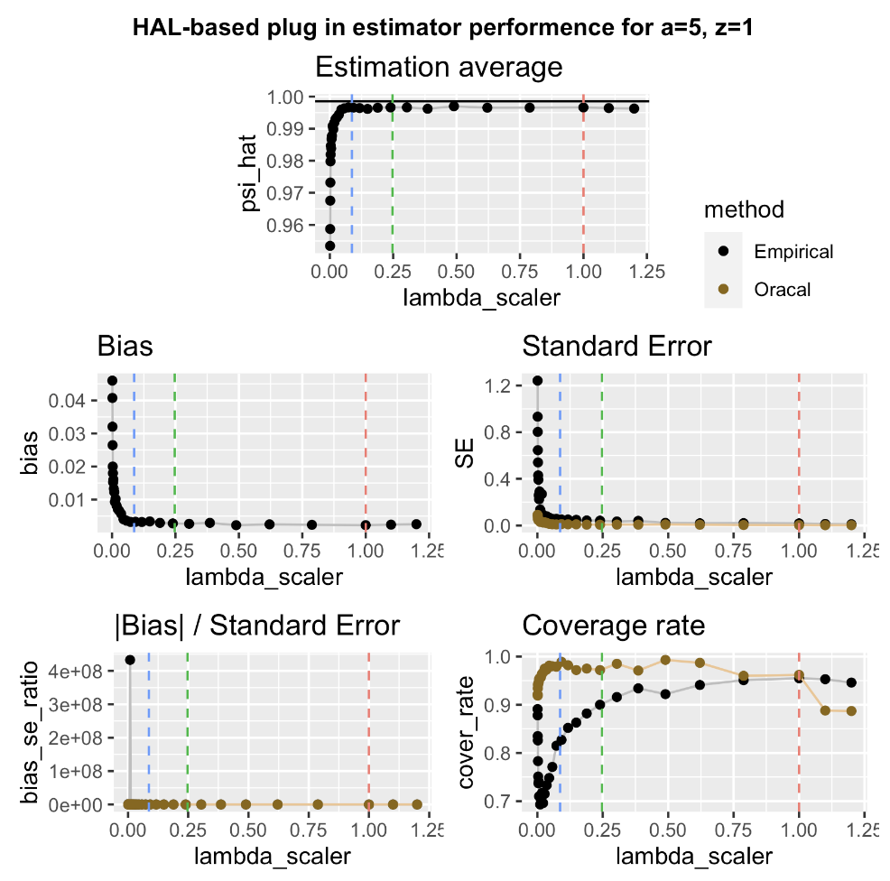
1000 Samples, n=1000

Slide 15
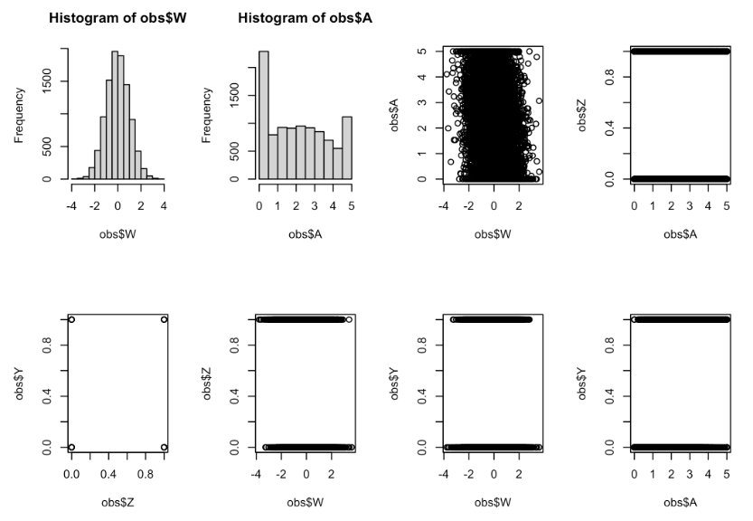
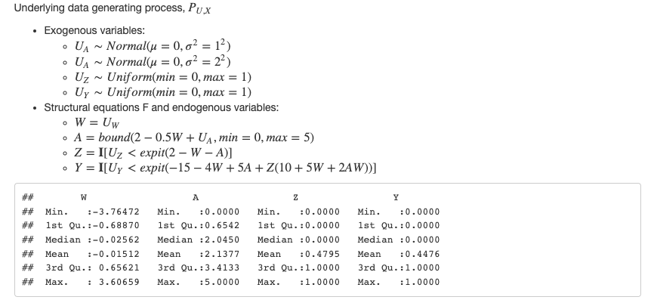
Simulation #2

Slide 16
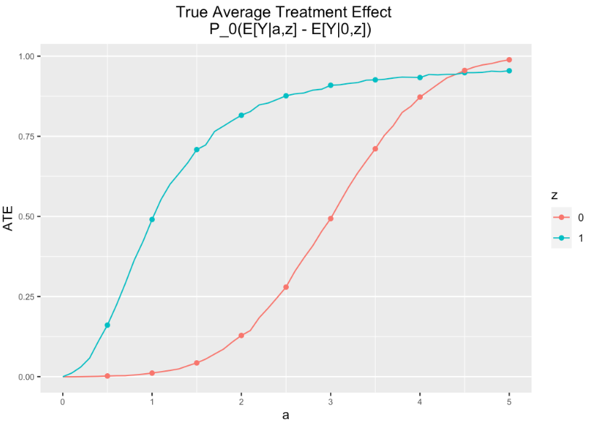
Simulation #2

Slide 17
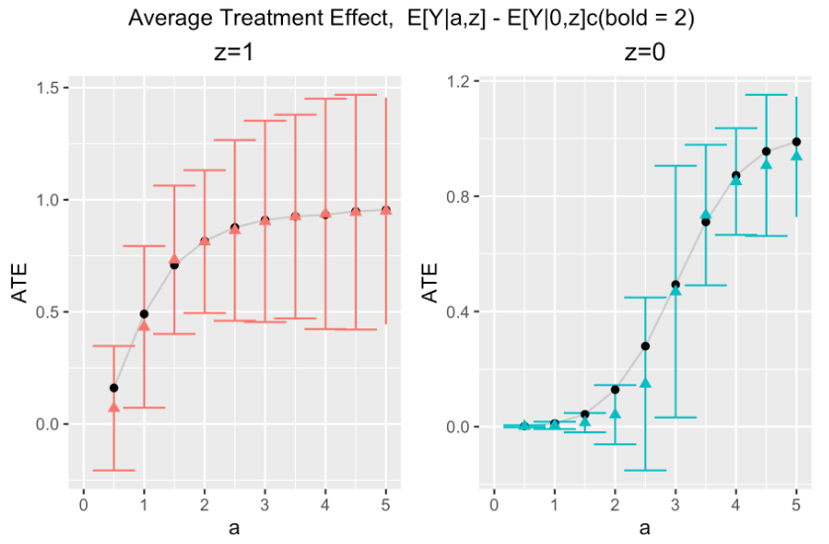
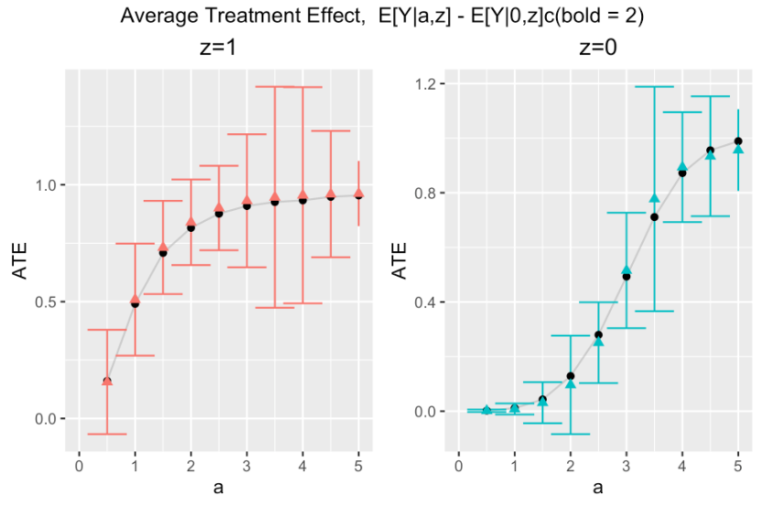
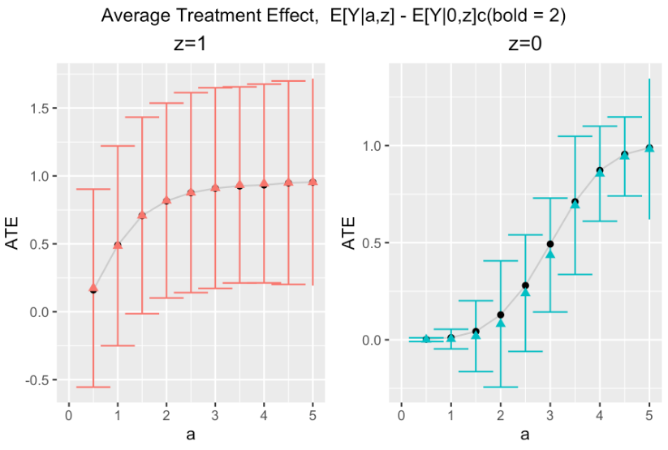
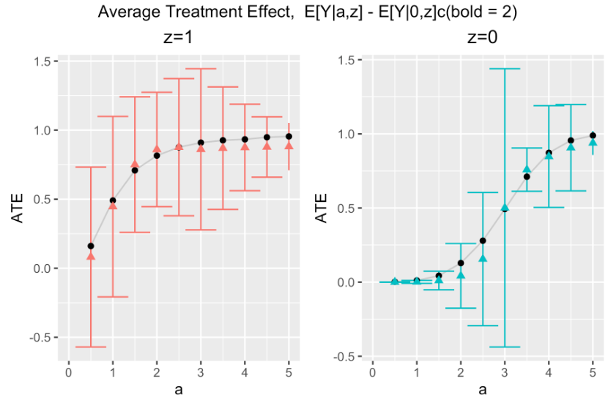
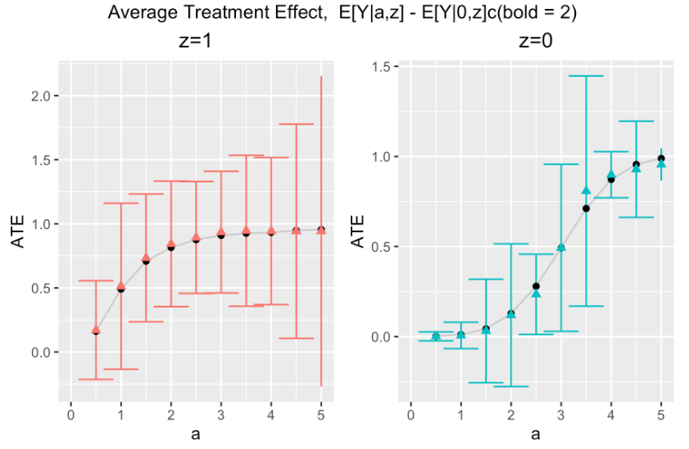
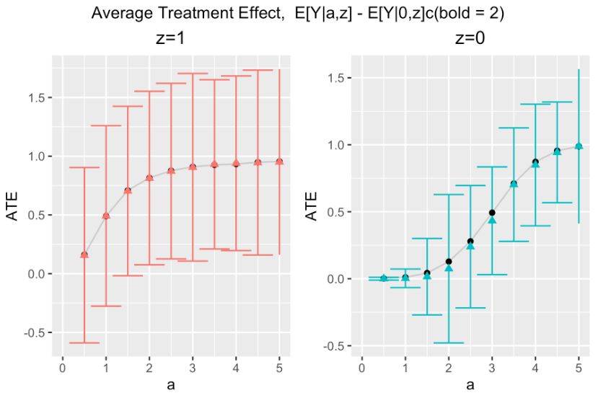
n = 200
n = 500
n = 1000
CV-HAL
Globally
undersmoothed
HAL
Undersmoothing lambda scaler
0.23357
0.16237
0.48329

Slide 18
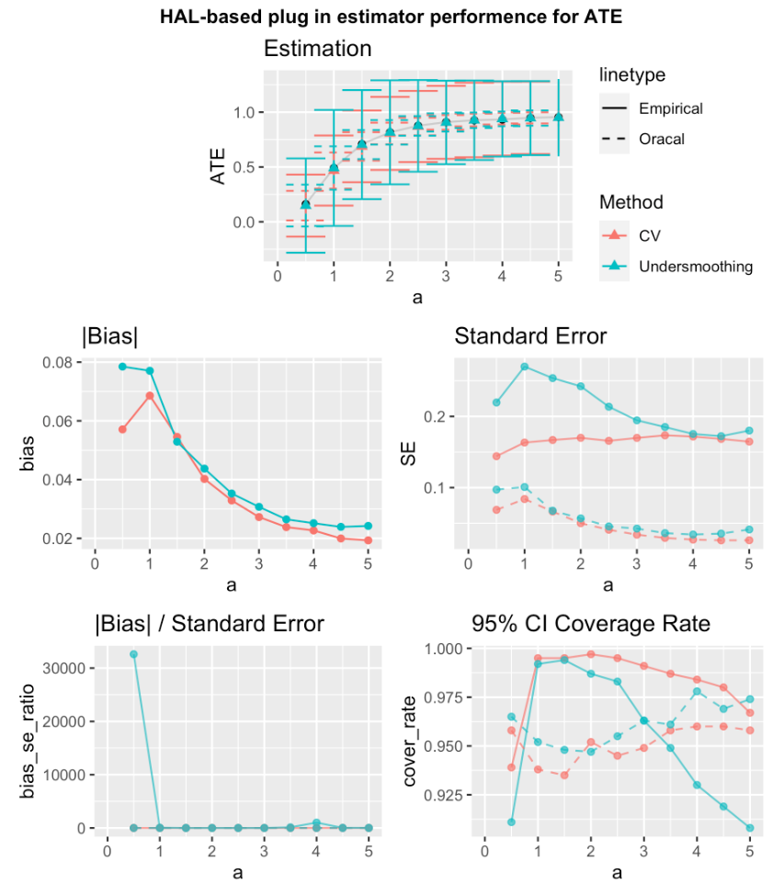
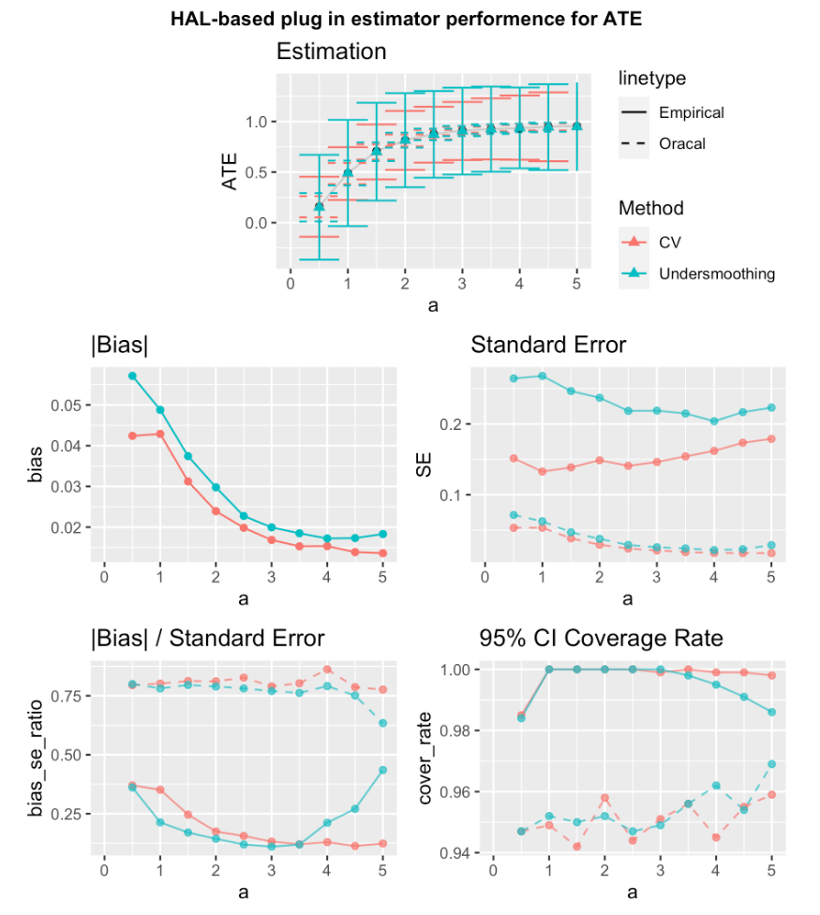
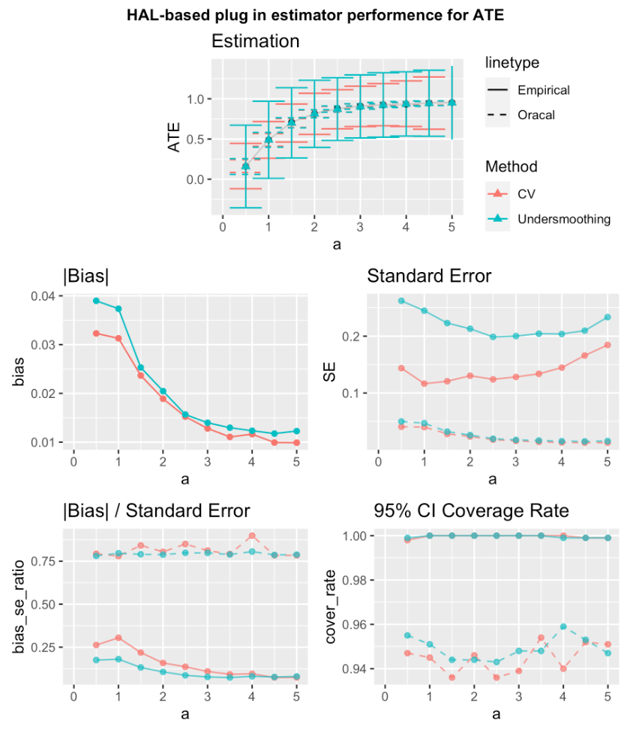
Z = 1
n = 200
n = 500
n = 1000

Slide 19
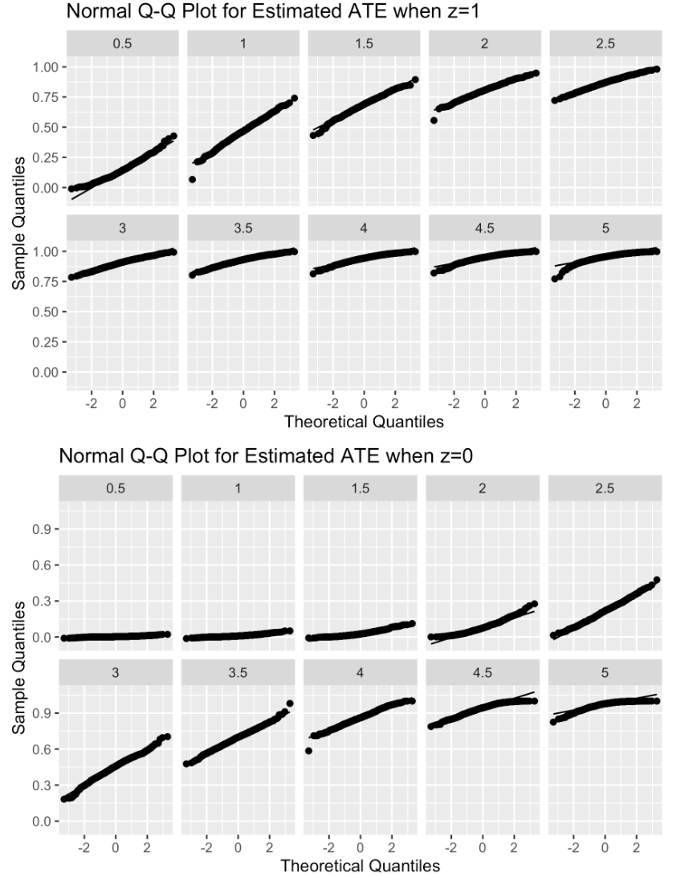
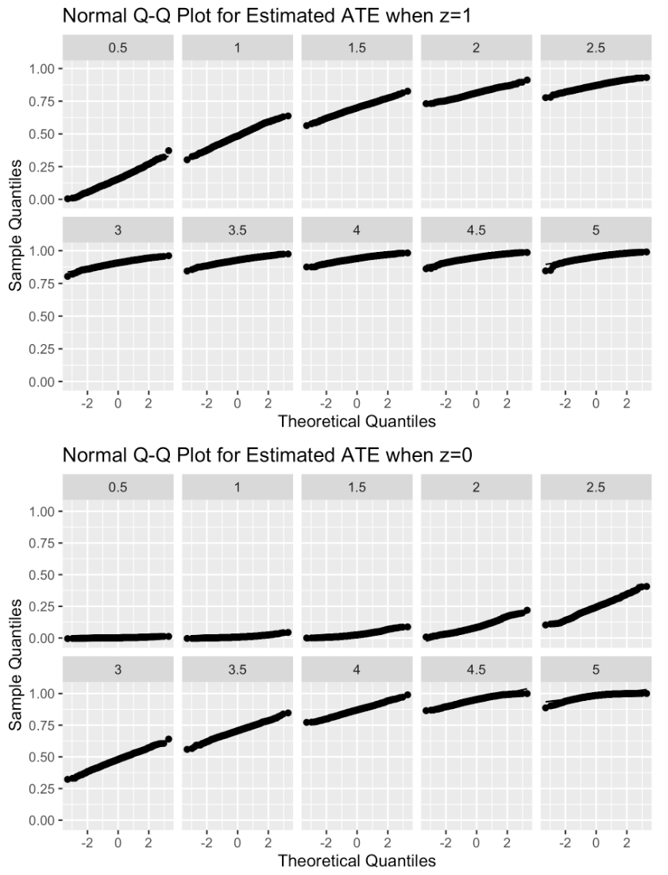
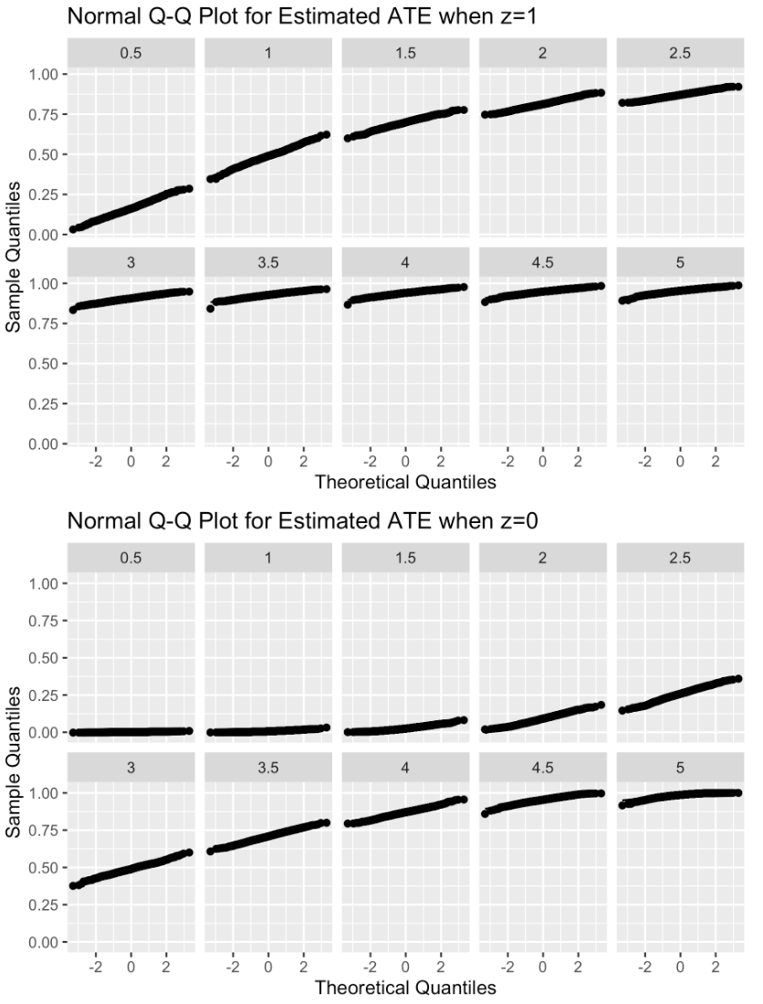
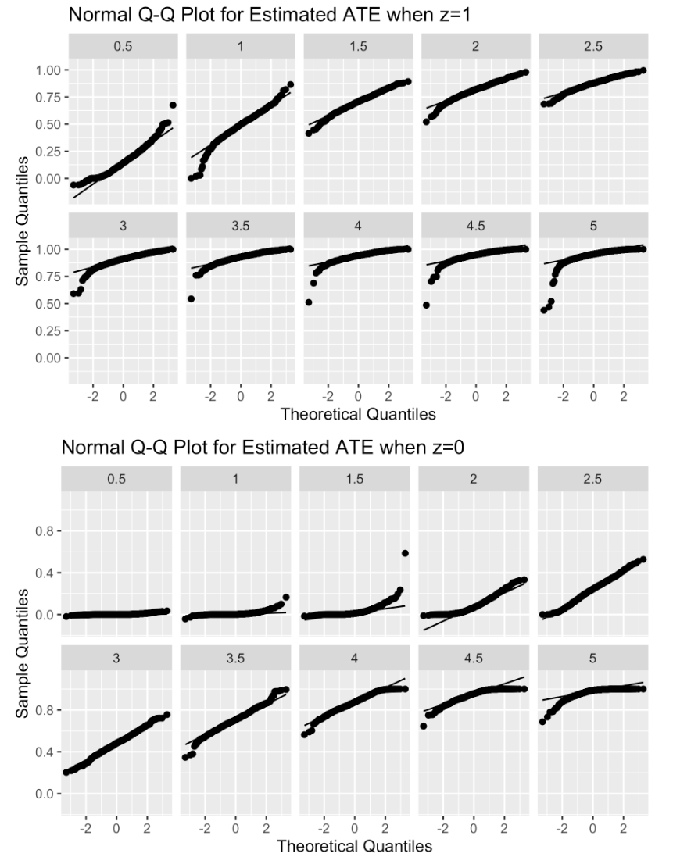
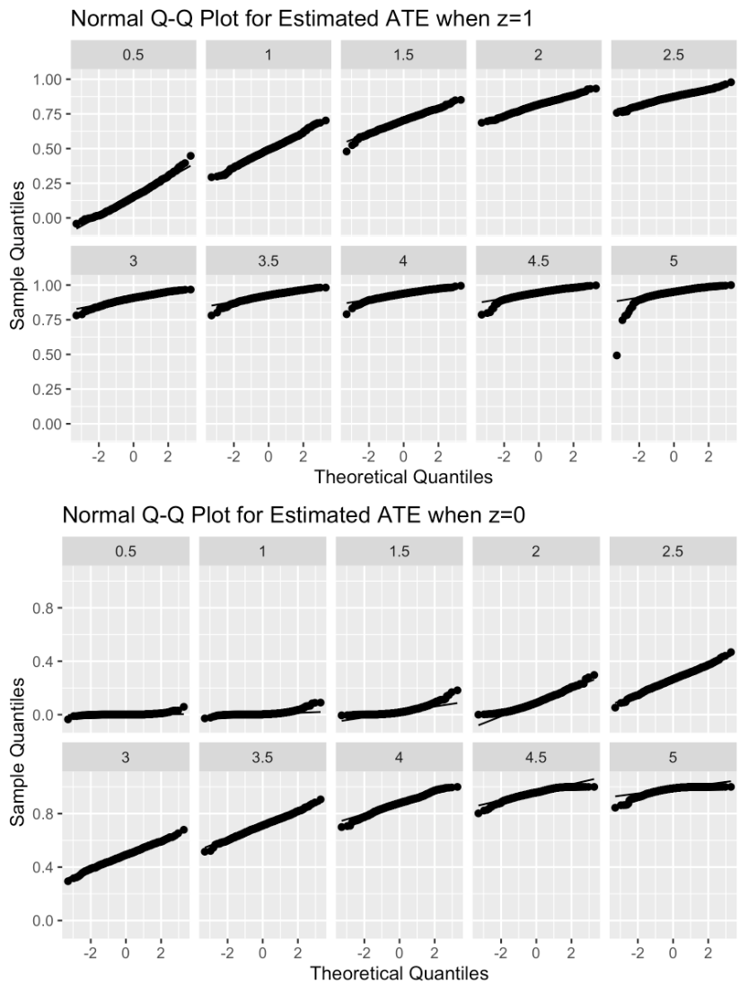

1000 Sample
n = 200
n = 500
n = 1000
CV-HAL
Globally
U-HAL

Slide 20



1000 Samples, n=200
Avg_scaler = 0.21777

Slide 21



1000 Samples, n=500
Avg_scaler = 0.21359

Slide 22



1000 Samples, n=1000
Avg_scaler = 0.21359

Slide 24


Simulation #3

Slide 25

Simulation #3

Slide 26
Simulation #3

Slide 27






n = 200
n = 500
n = 1000
CV-HAL
Globally
undersmoothed
HAL
Undersmoothing lambda scaler
0.23357
0.16237
0.16237

Slide 28


Red lines are results from using L1 Penalty based on minimizing CV-risk (CV-HAL).
Blue lines are results using an empirical derived global undersmoothing based repeated simulations over a grid of L1 penalties and choosing the maximal one for which the bias becomes negligible.
Results are shown for a grid over A=a. Dashed line is based on the Oracle SD of the estimator, solid on the empirical delta method.
n = 500, z = 1
n = 1000, z = 1

Slide 29




1000 Sample
n = 500
n = 1000
CV-HAL
Globally
U-HAL

Slide 30


1000 Samples
n = 500
N =1000
CV-HAL
Globally
U-HAL

Slide 31
Simulation #3

